Slide 1
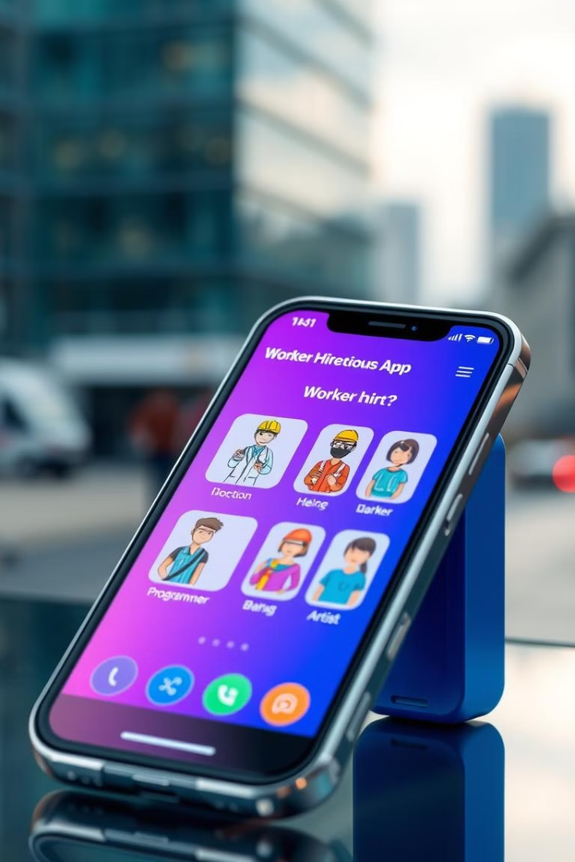

Worker-Hiring App: Revolutionizing Service Connections
Introducing our innovative web platform that seamlessly connects customers with skilled workers. Our app streamlines the process of finding and hiring professionals for various services, from home maintenance to specialized industry jobs.

Slide 2

Project Objective
1
Efficient Connections
Create a user-friendly platform for quick and easy worker-customer matches.
2
Diverse Services
Cater to various industries including home maintenance, construction, and specialized sectors.
3
Secure Transactions
Implement robust security measures for user verification and payment processing.

Slide 3
User Types and Roles
Admin
Workers
Customers
Oversees platform operations, manages users, and monitors job listings.
Create profiles, showcase skills, and apply for jobs posted by customers.
Post job listings, search for workers, and hire based on their specific needs.

Slide 4

User Registration Process
1
Account Creation
Users provide basic information and choose their account type (worker or customer).
2
ID Verification
Upload government-issued ID for identity verification and enhanced security.
3
Profile Completion
Add detailed information, skills, and preferences to optimize matching.

Slide 5

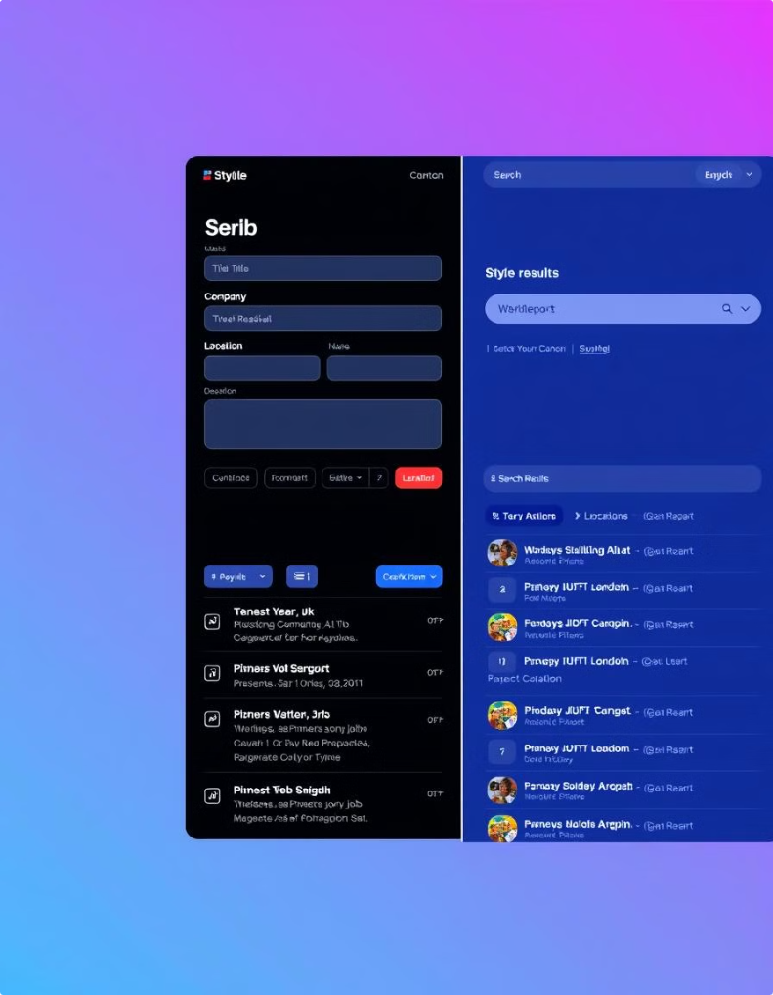
Job Posting and Search Features
Detailed Job Listings
Customers can create comprehensive job postings with specific requirements and preferences.
Advanced Search Filters
Workers can easily find relevant jobs using location, skill, and industry filters.
Smart Matching Algorithm
Our system suggests suitable workers to customers based on job requirements and worker profiles.
Real-time Notifications
Users receive instant alerts for new job postings or application updates.

Slide 6
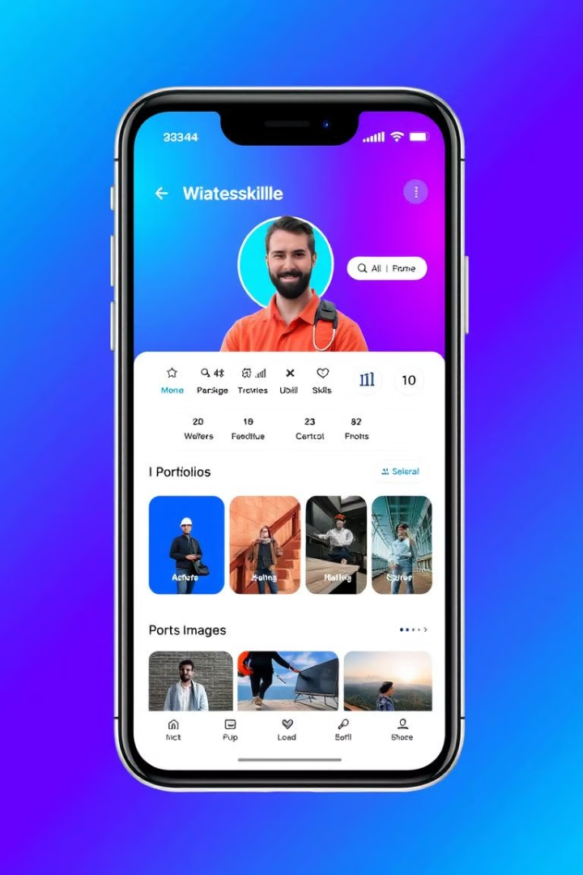



Worker Profile Creation
Work History
Workers can showcase their experience and past projects to attract potential clients.
Ratings and Reviews
Customers can rate workers, building trust and credibility within the platform.
Skill Verification
Workers can add certifications and undergo skill assessments for added credibility.

Slide 7





Payment Integration
Contract Creation
Secure Escrow
Milestone Payments
Final Transfer
Customers and workers agree on job terms and pricing.
Funds are held securely until job completion, protecting both parties.
For longer projects, payments can be released in stages as milestones are met.
Funds are released to the worker upon customer approval of completed work.

Slide 8

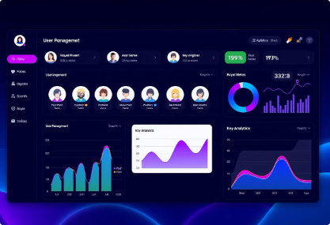
Admin Management Features
User Management
Job Listing Oversight
Dispute Resolution
Verify user accounts
Monitor and approve job postings
Mediate conflicts between users
Manage user permissions
Remove inappropriate content
Review and process refund requests
Generate user reports
Analyze job market trends
Implement platform improvements based on feedback

